Slide 1
The Croak Twins
From Pads to Riches
A game by Ben Reynolds and Elliot Page

Slide 2
Concept
A two-player local multiplayer game.
Centred around destructive gameplay.
Achieved using a swing mechanic.
Aimed at 18-24 year old males.
For PC, released as a standalone.

Slide 3



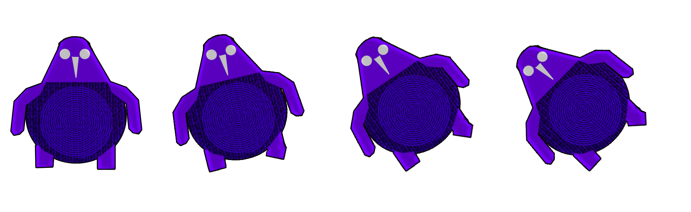

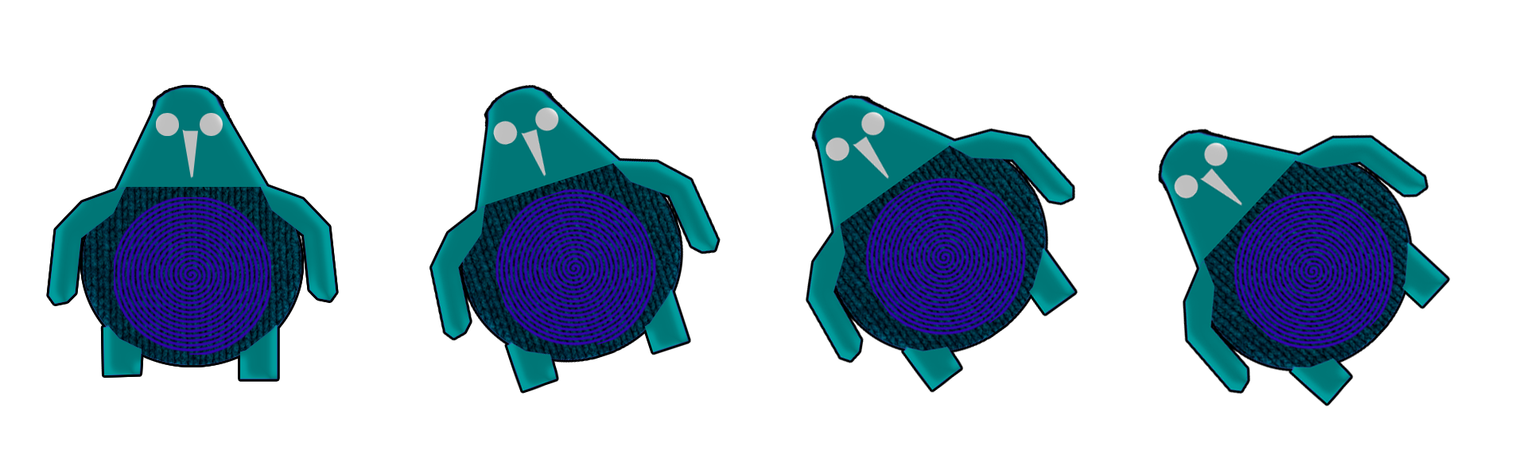

Art Style (Iterations)

Slide 4


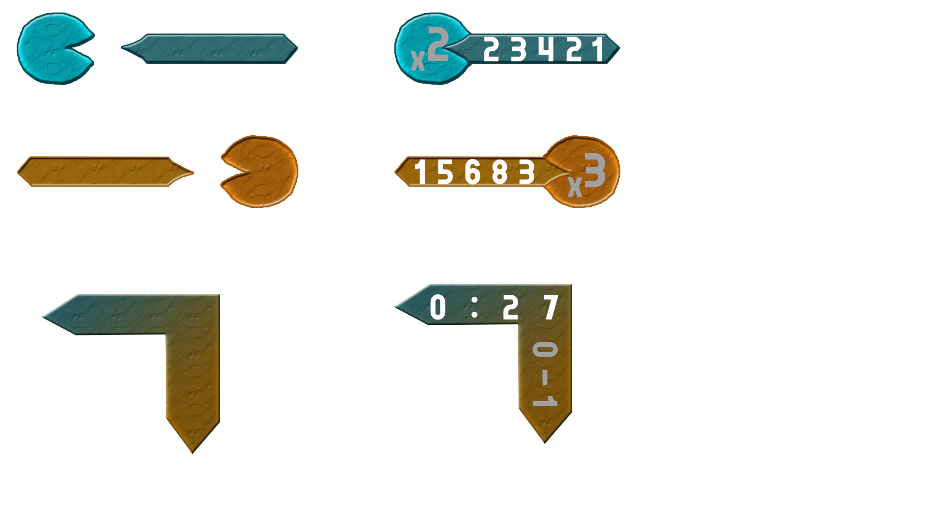
Art Style (Final)

Slide 5
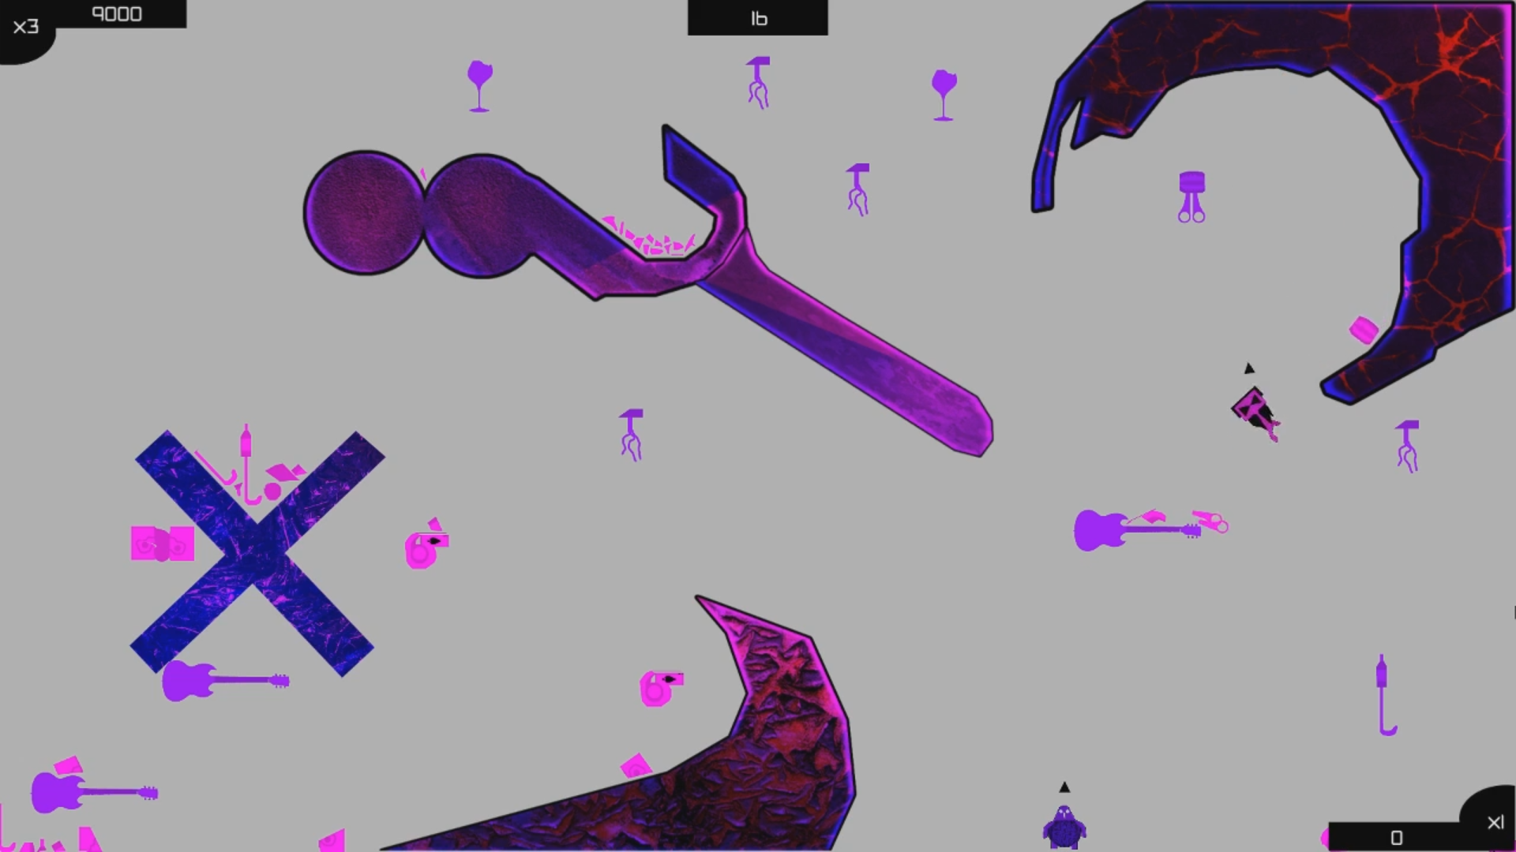
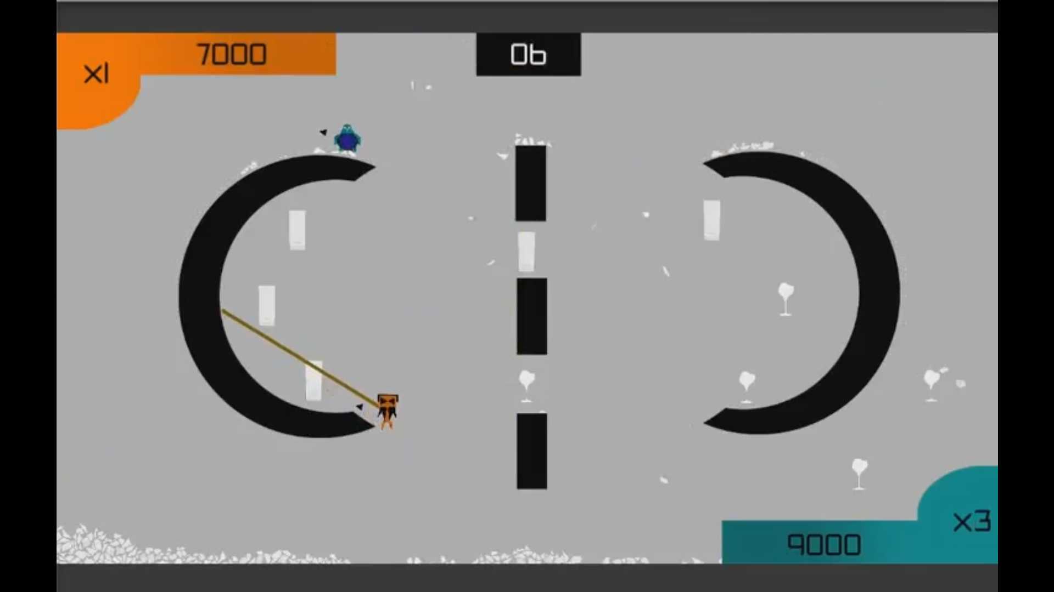
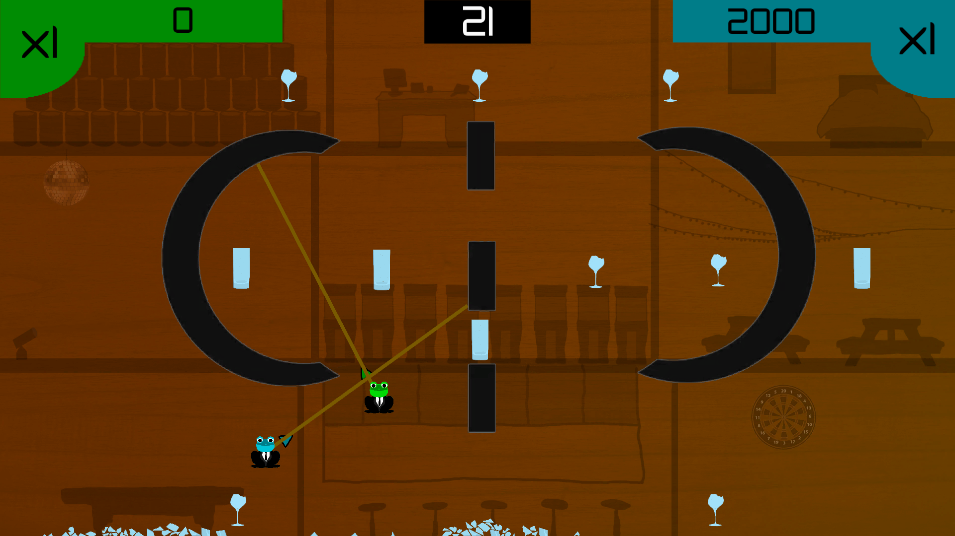
Gameplay (Iterations)
(Game Here)

Slide 6
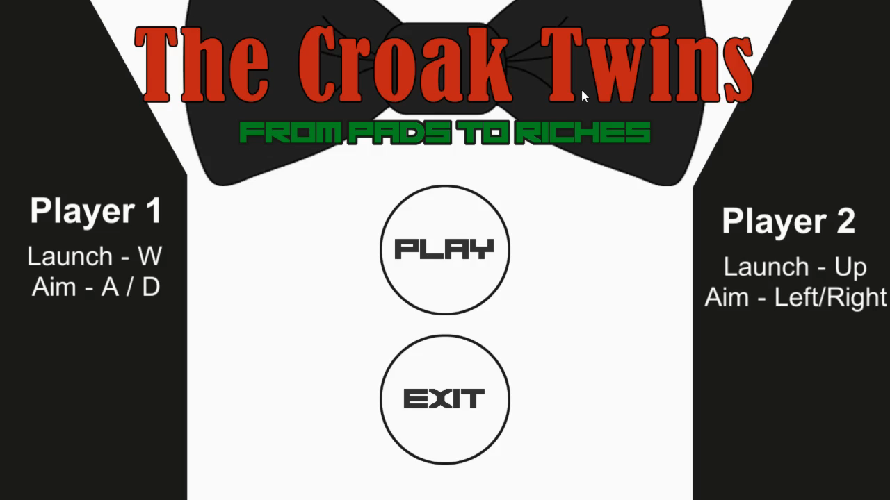
Gameplay (Final)

Slide 7
Feedback
(Feedback Here)

Slide 8
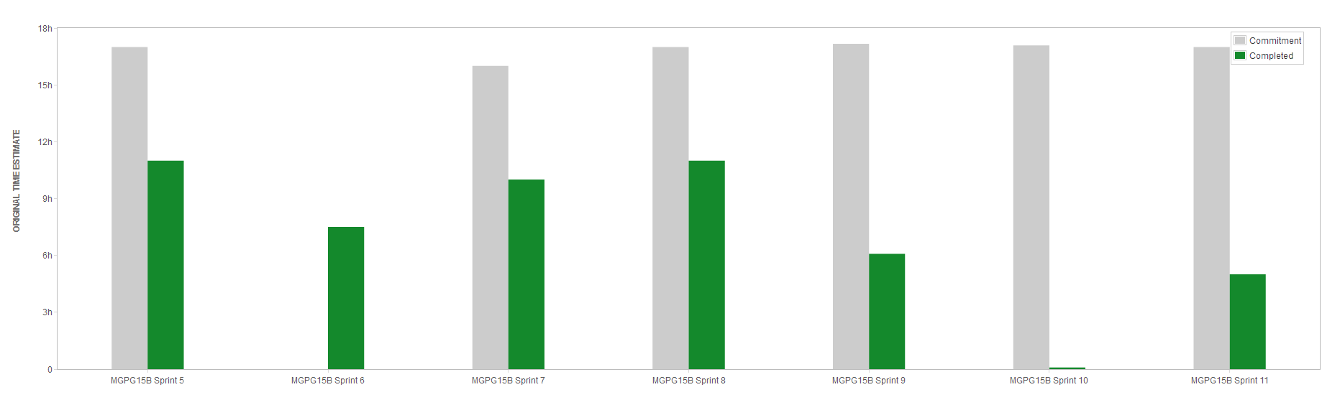
Teamwork/Management

Slide 9
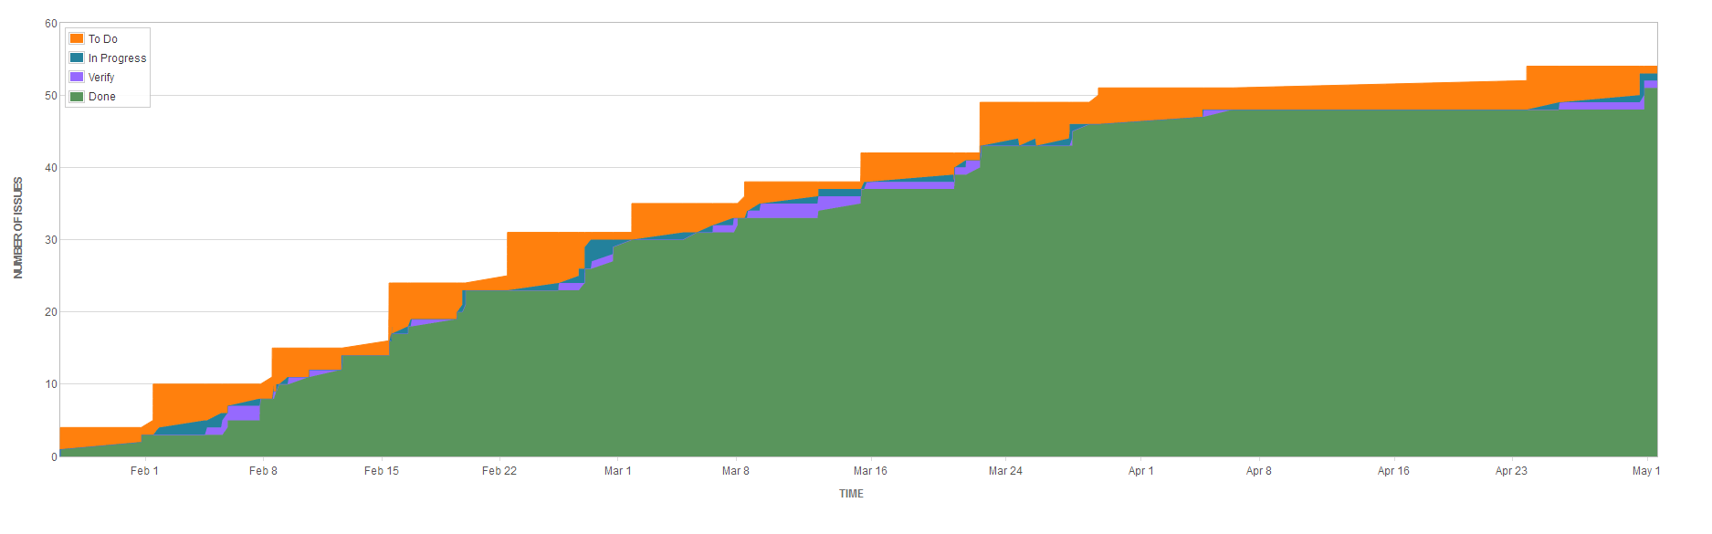
Teamwork/Management

